Slide 1
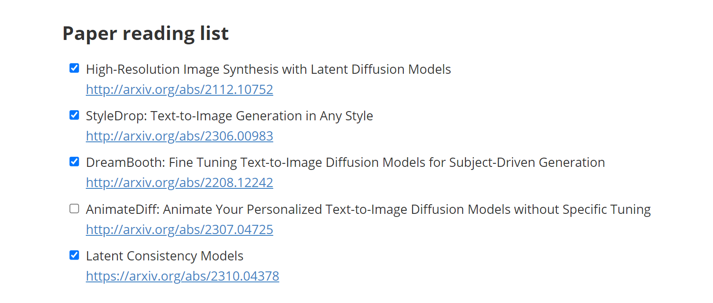

Slide 2
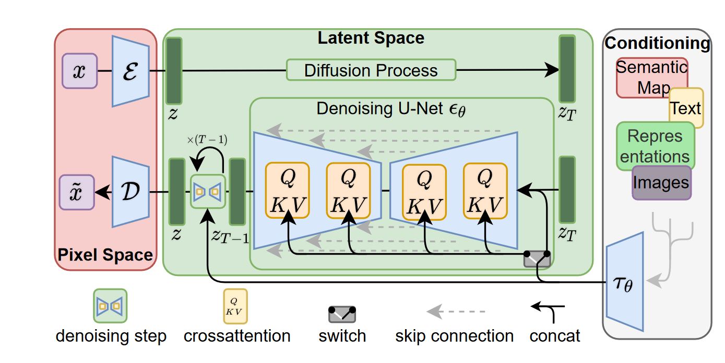
LDM
Latent space representation

Slide 3
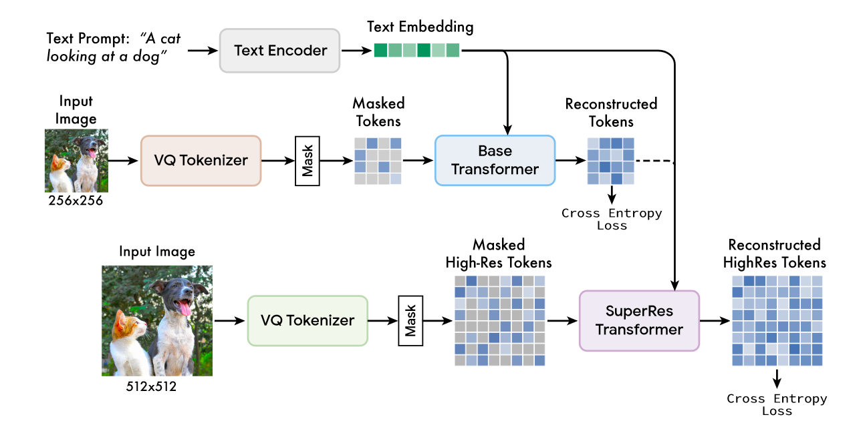
Styledrop
1.Muse:T2I generation via masked generative transformers

Slide 4
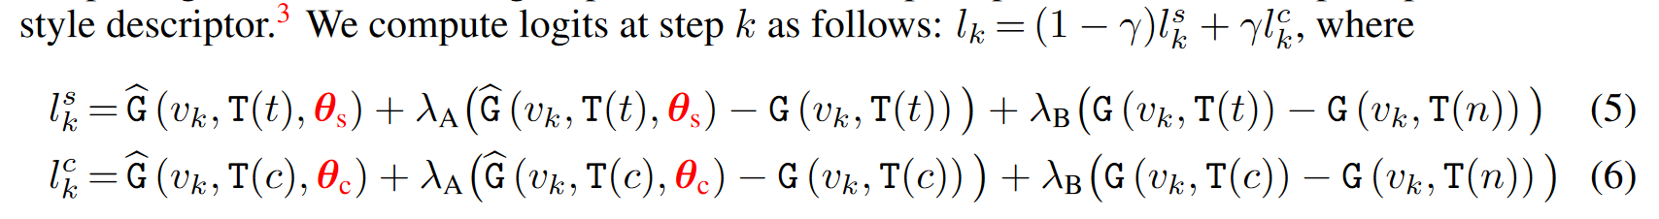
2.PEFT
3.Constrcting text prompt
4.Iteration training with feedback（CLIP/HF）
5. Two θ’s（θ-c, θ-s）

Slide 5
LCM
1.Accelerating DMs.(ODE solvers and distillation)
2.Consistency Models (CMs)
CMs adopt consistency mapping to directly map any point in ODE trajectory to its origin
3. Consistency distillation in the latent space
4.Class-free guided distillation

Slide 6
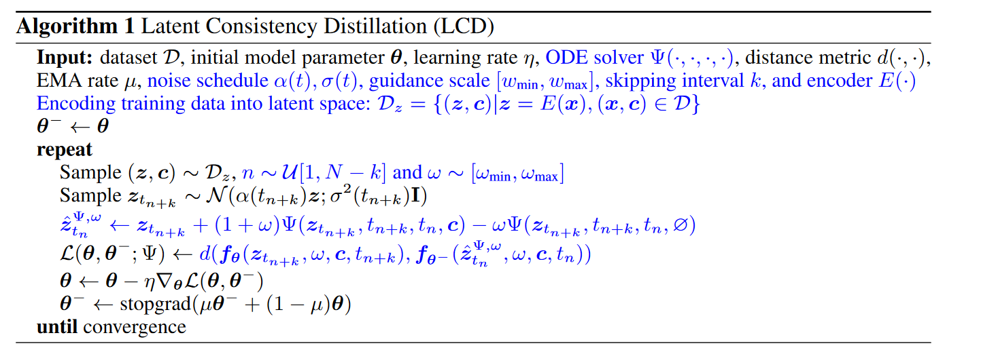
LCM Algorithm

Slide 7
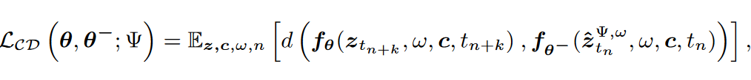
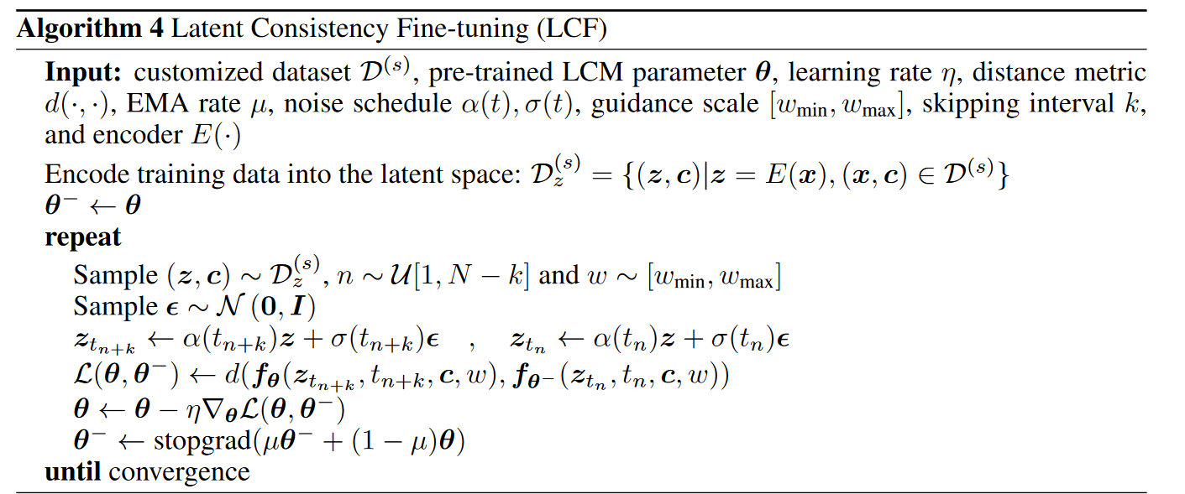
5.Accelerating distillation
6.LCFine-Tuning

Slide 8
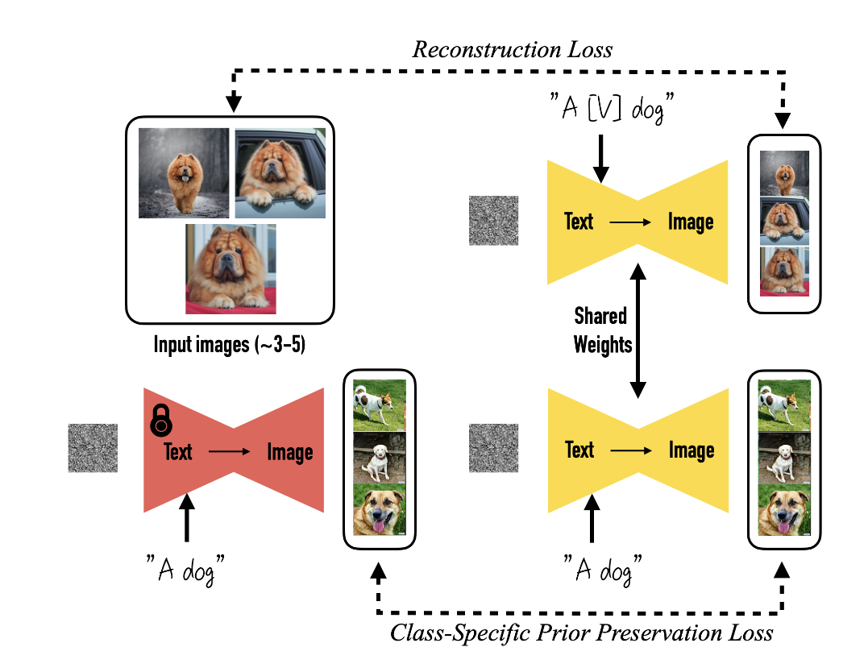
DreamBooth
1.Controlable editing
GAN(variety）Diffusion models（global editing）
无法细粒度控制，仅文本输入控制，无法保持主体一致
Language drift
2.Personalization models
Designing Prompts for Few-Shot Personalization
Rare-token Identifiers
3. Class-specific Prior Preservation Loss

